Slide 1
Turtle Functions (What he can do)
turtle1.moveForward(dist); turtle1.rotate(degrees); turtle1.moveForwardTo(X,Y);
 | turtle1.drawSquare(X,Y,length)
turtle1.setPenDown(); turtle1.setPenUp(); | turtle1.drawTriangle(X,Y,length);
turtle1.setPenUp(); | turtle1.drawHexagon(X,Y,length);
turtle1.setPenColour(colour) turtle1.setPenWidth(width) | turtle1.drawRectangle(X,Y,width,height);
 | showGrid(true);
turtle1.setPenWidth(width) | add(Pip,X,Y);

Slide 2
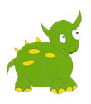
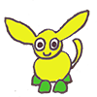
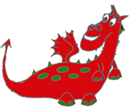
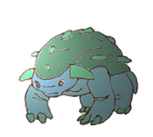
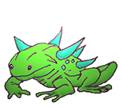
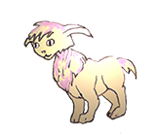
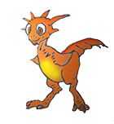
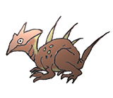
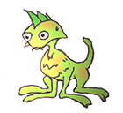
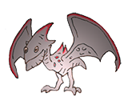
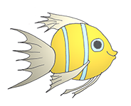
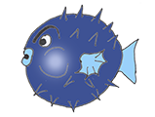
Pip Grog Jig Mop Flup Zon Saff Drax
Suri Jek Klos Mif Riz Vash Wemz
Angelica Puffy shrimp seaweed bee tree ant

Slide 3
Pip Grog Jig Mop Flup Zon Saff Drax
Suri Jek Klos Mif Riz Vash Wemz
Angelica Puffy shrimp seaweed bee tree ant

